Slide 1
Online Shopping Cart Project

Slide 2
Team Introduction
Huy Bui
Full Stack
HuyBASE140028@fpt.edu.vn

Slide 3
01
Case Study

Slide 4
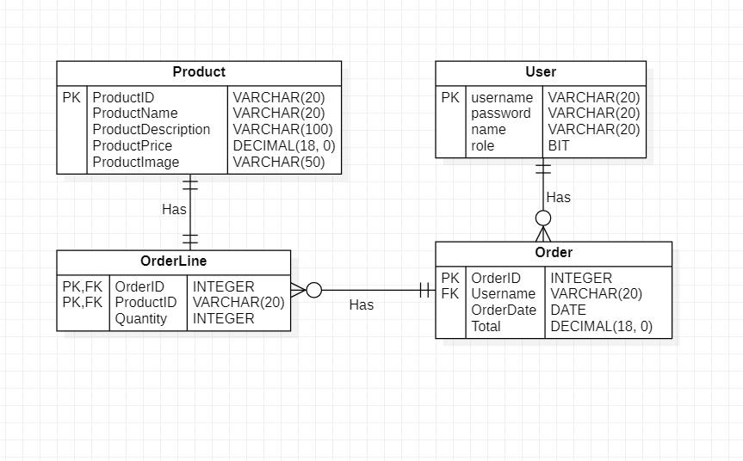
02 Database Design

Slide 5
03
System Design

Slide 6
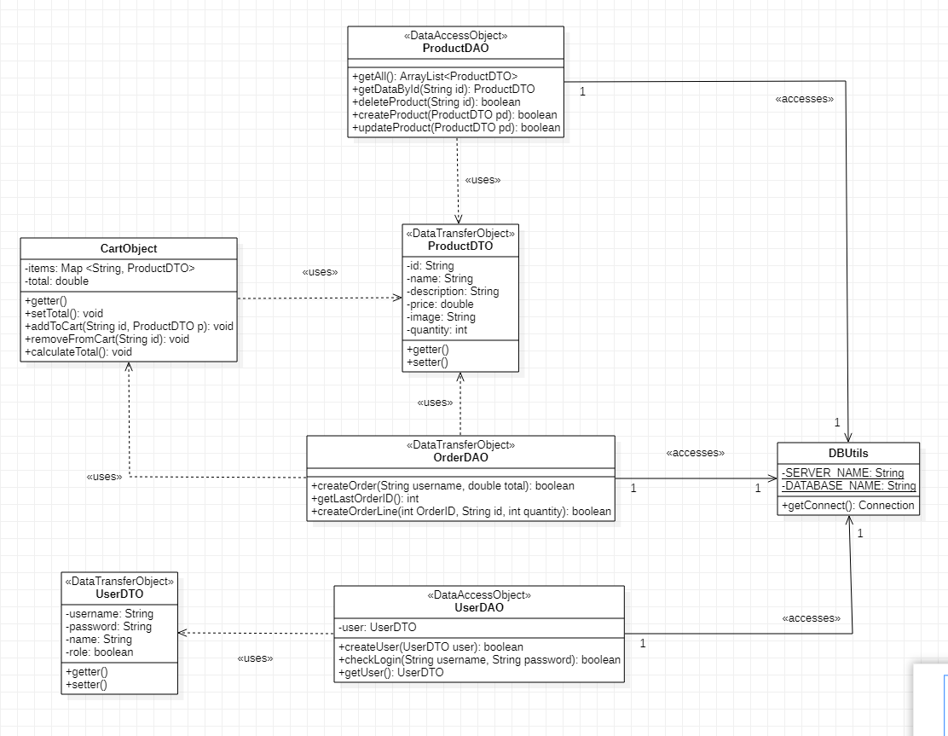

Slide 7
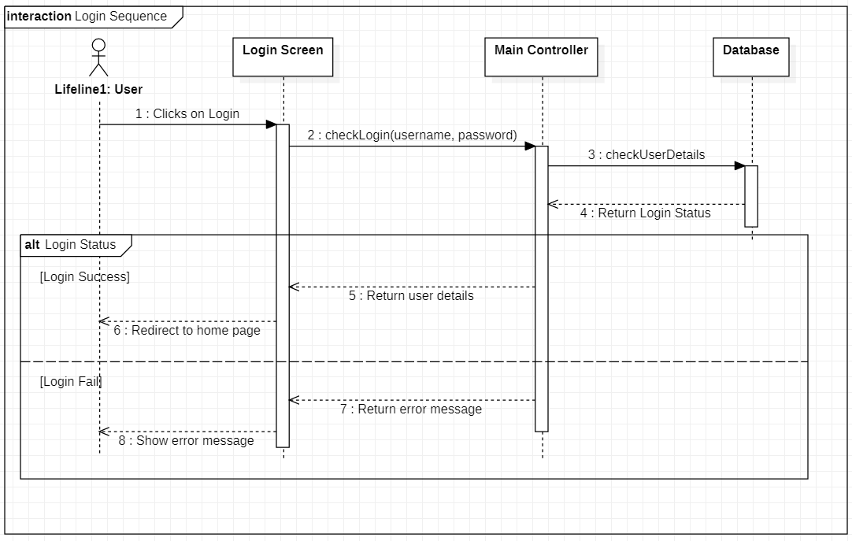

Slide 8
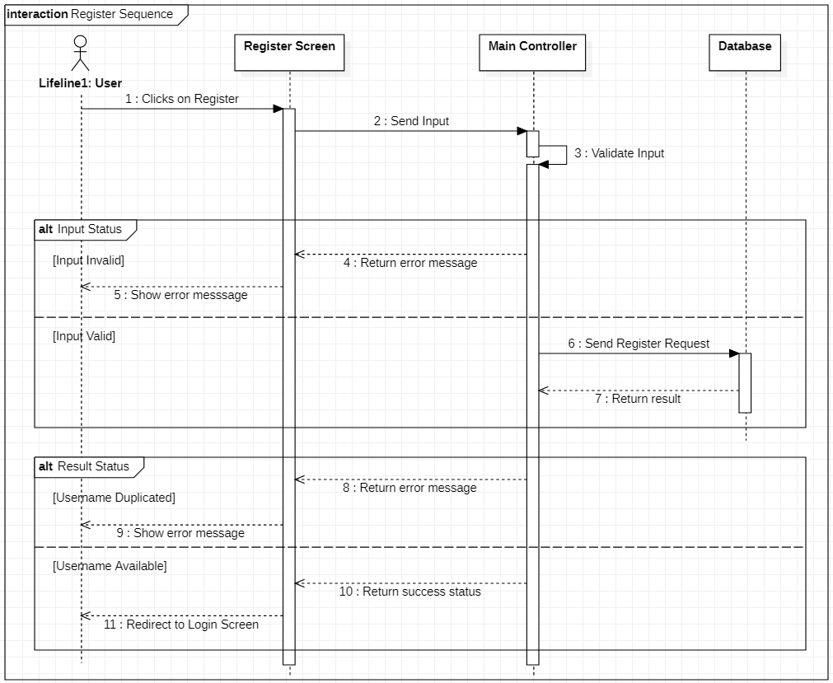

Slide 9
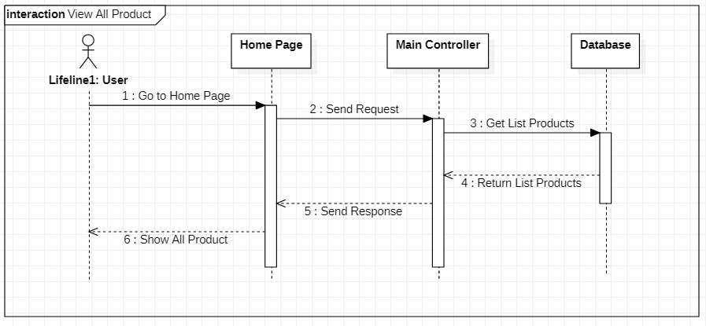

Slide 10
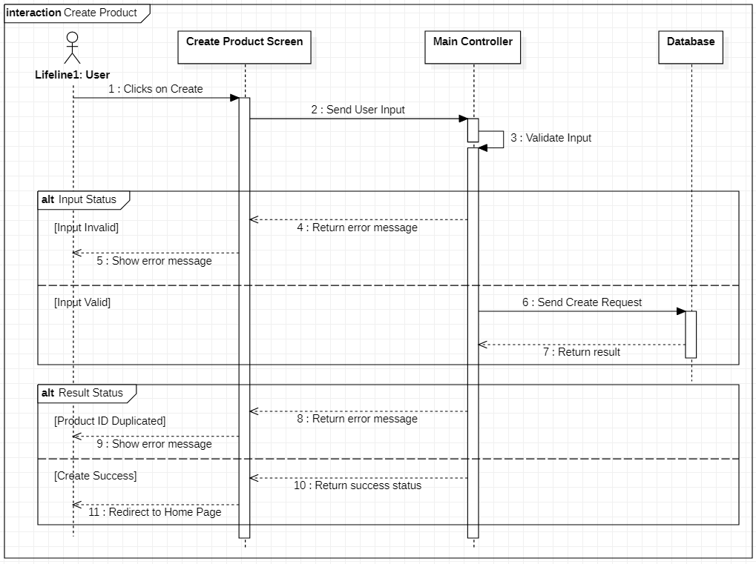

Slide 11
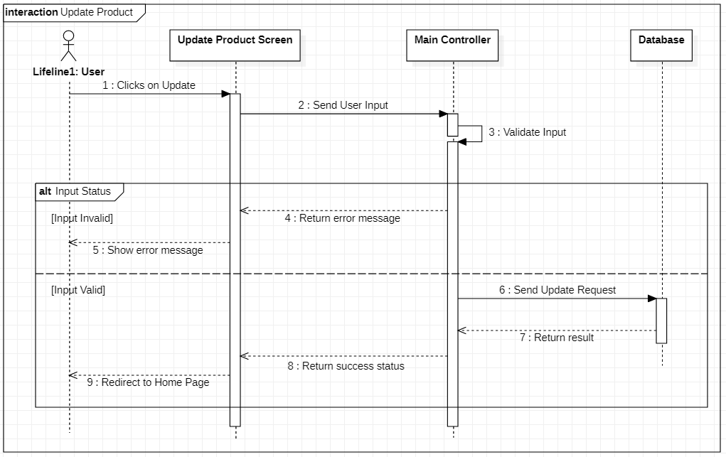

Slide 12
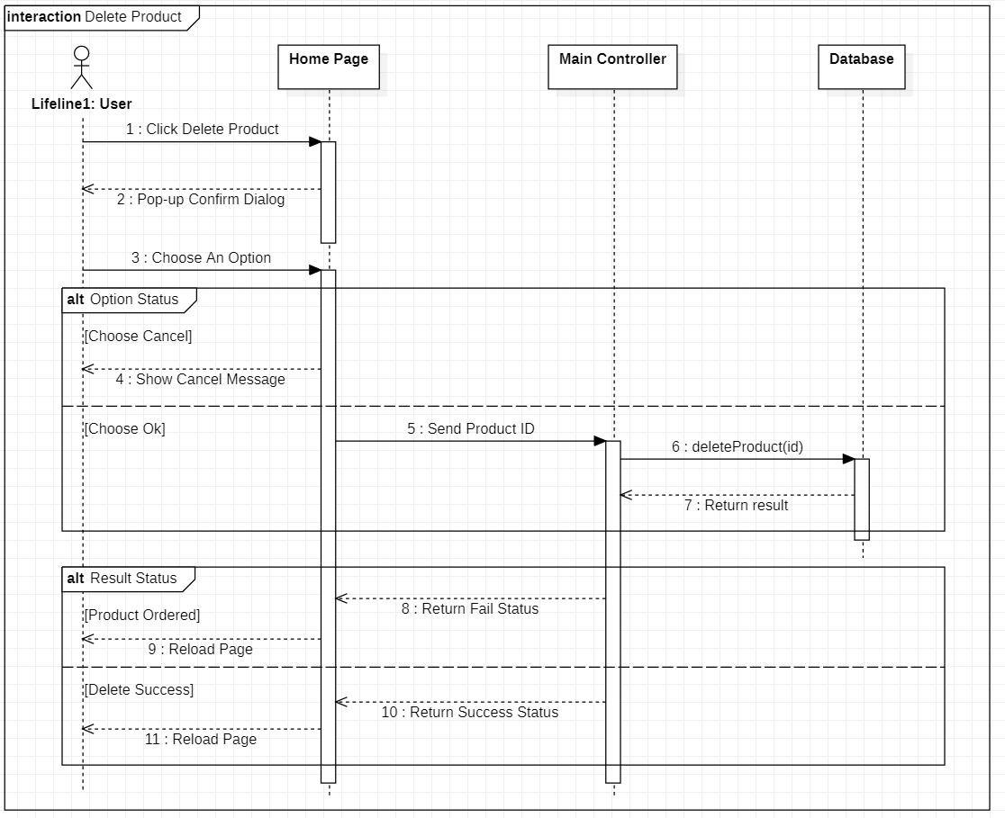

Slide 13
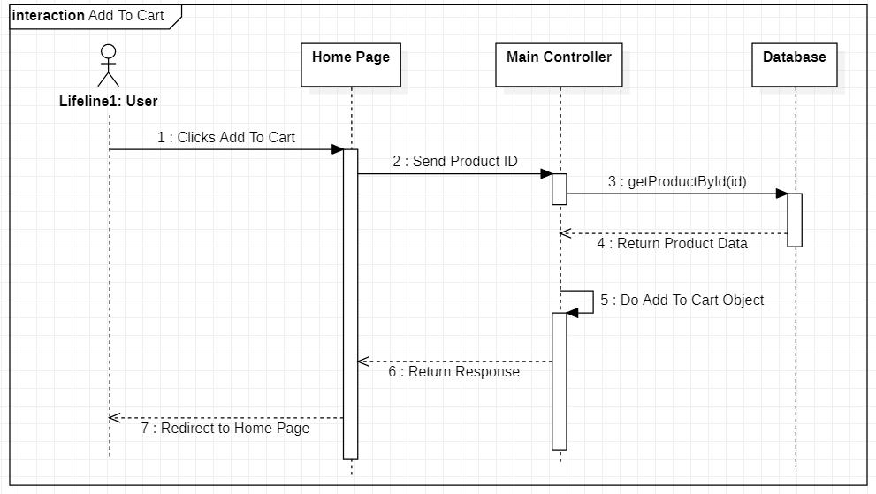

Slide 14
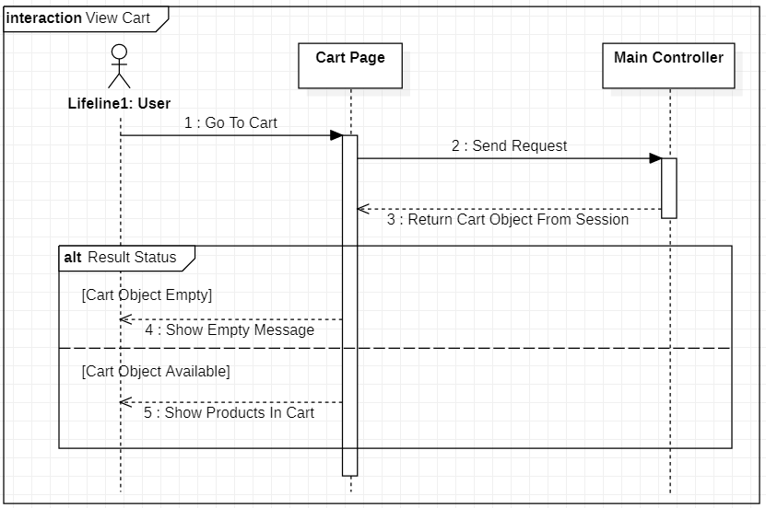

Slide 15
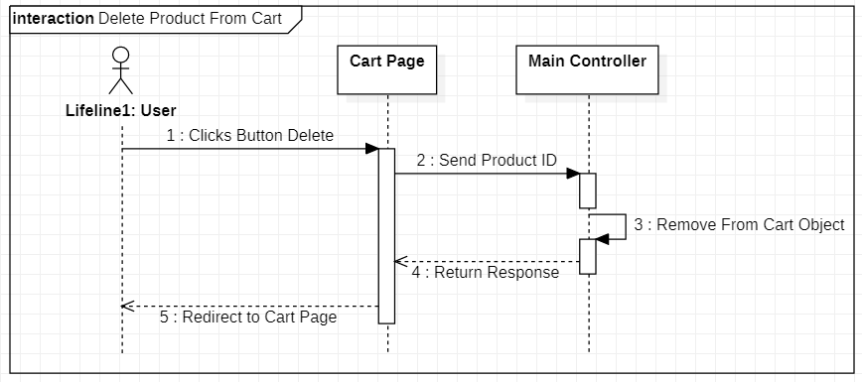

Slide 16
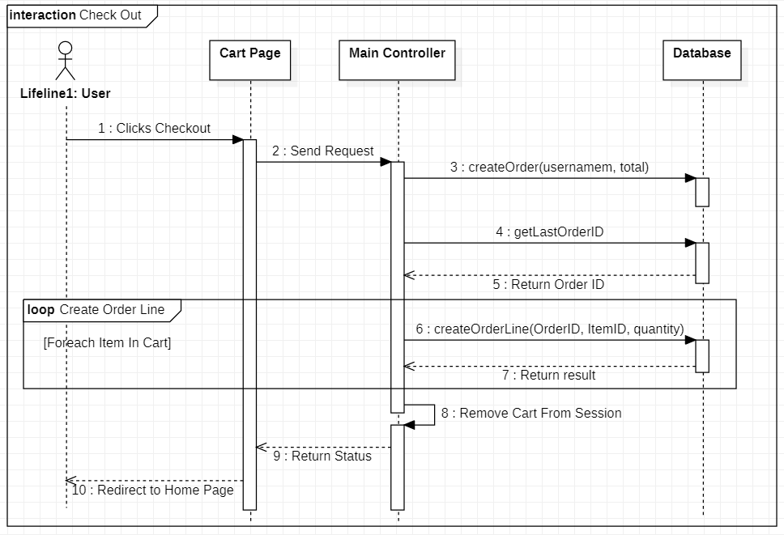

Slide 17
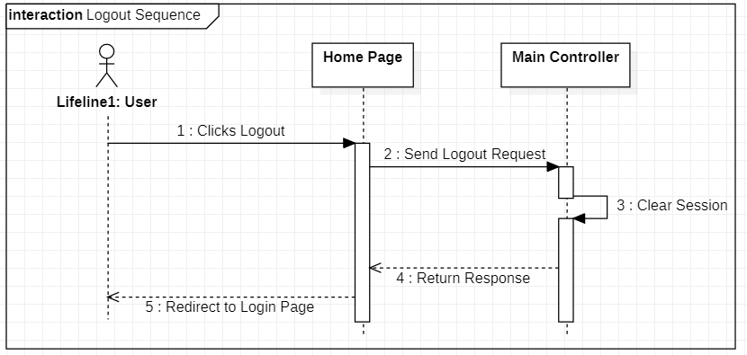

Slide 18
04
Screenshot

Slide 19
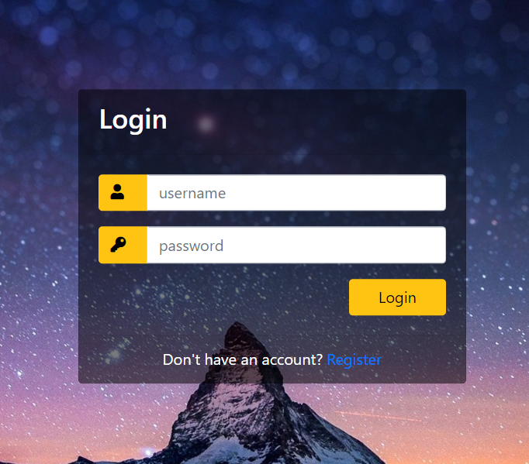

Slide 20
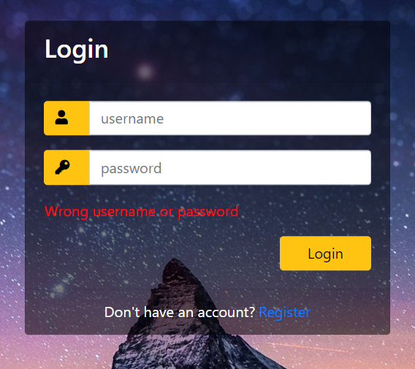

Slide 21
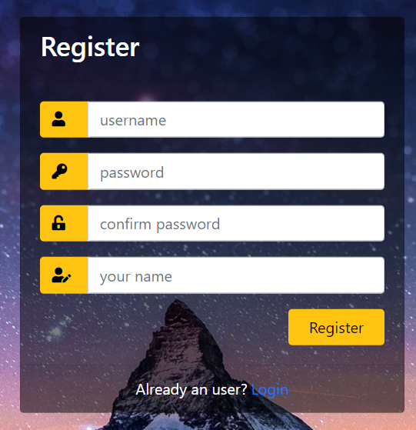

Slide 22
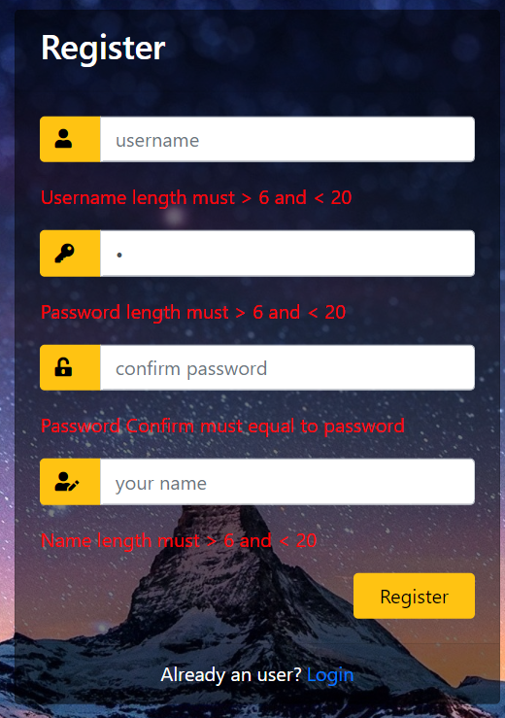

Slide 23
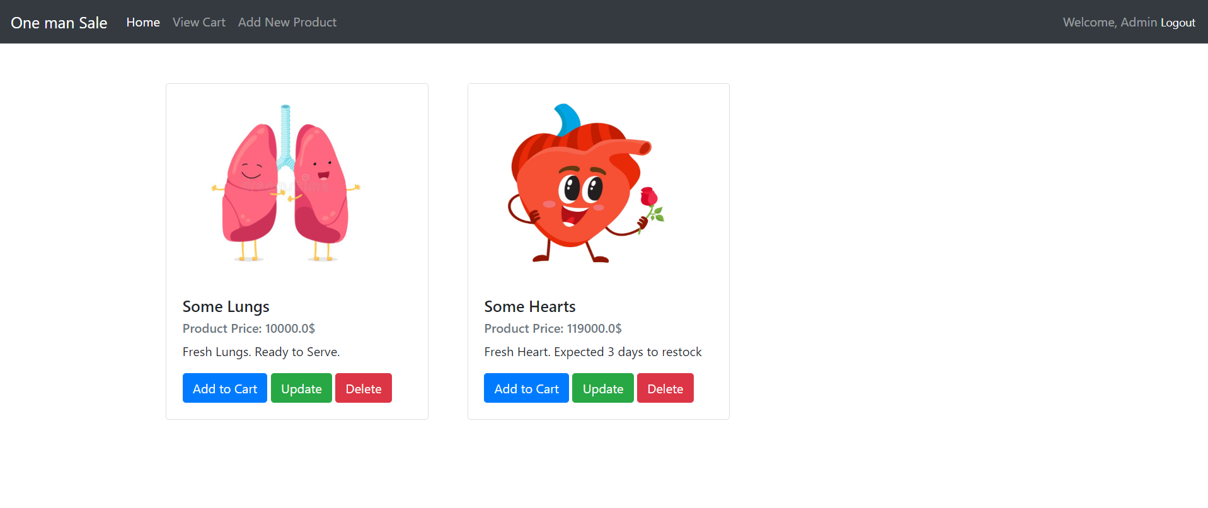

Slide 24
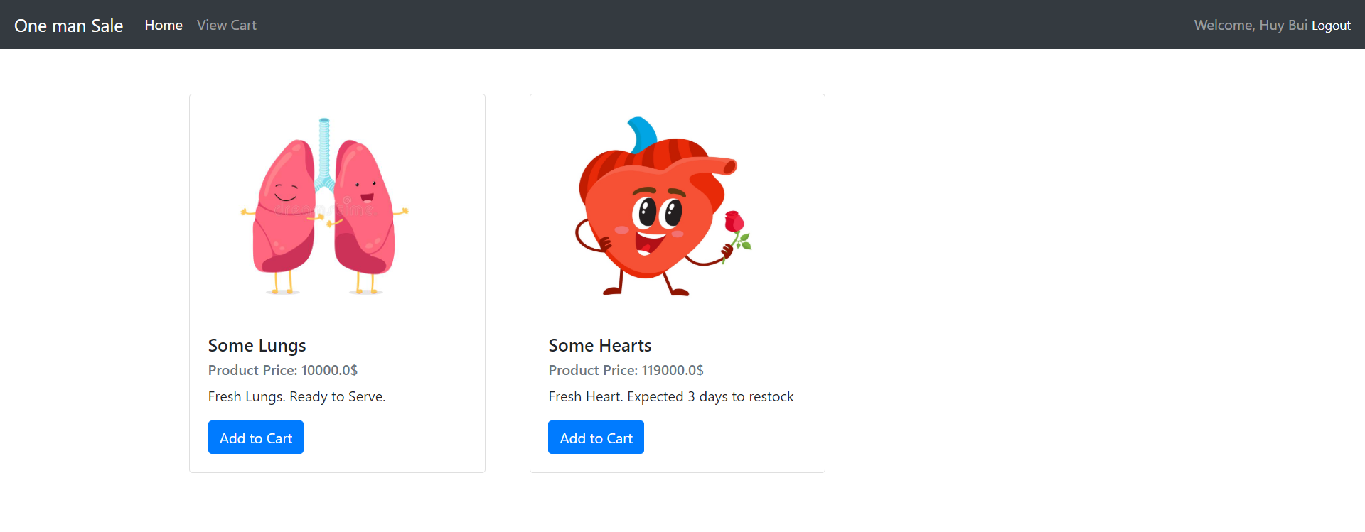

Slide 25
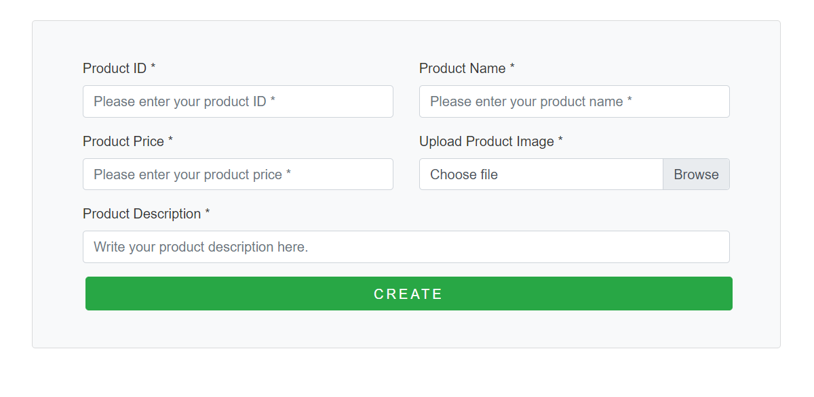

Slide 26
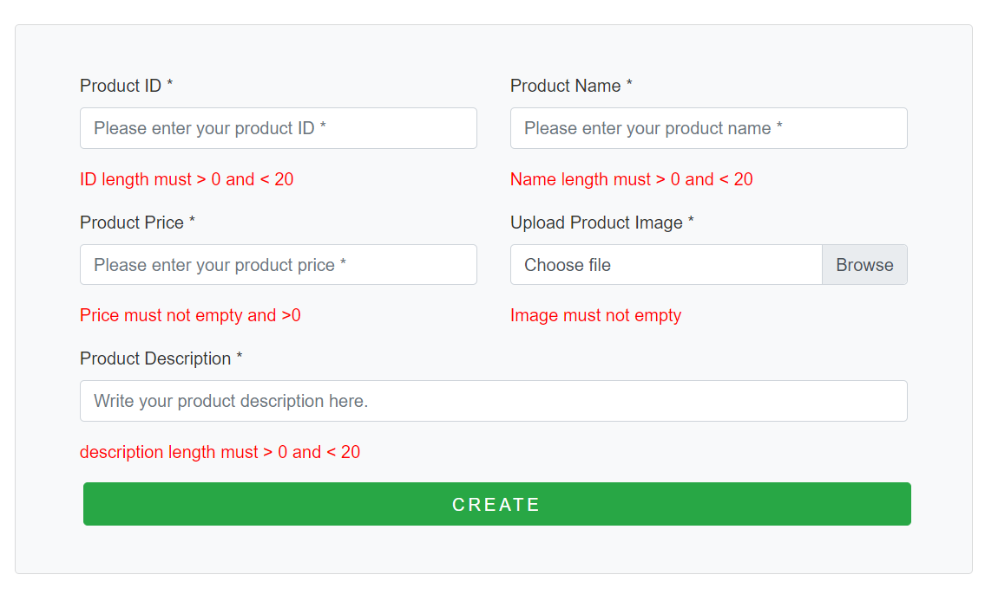

Slide 27
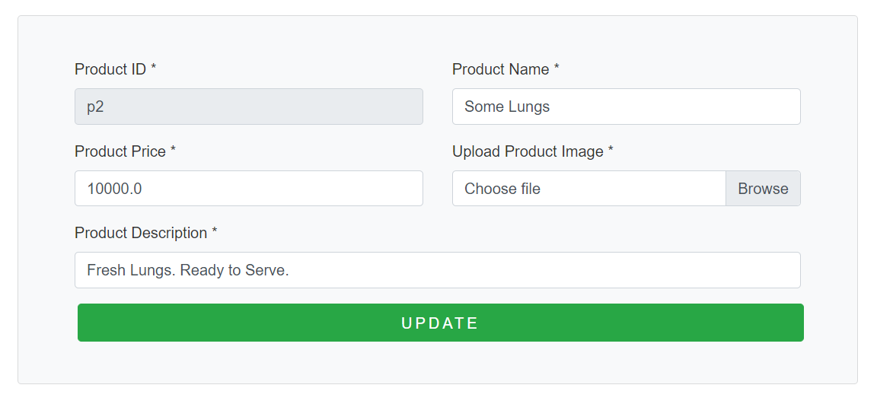

Slide 28
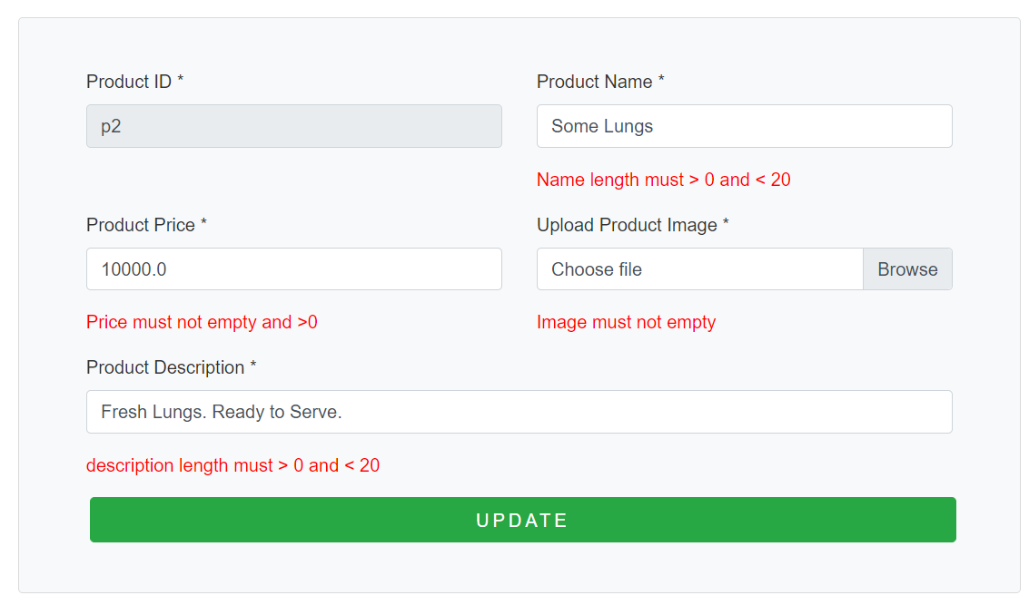

Slide 29


Slide 30
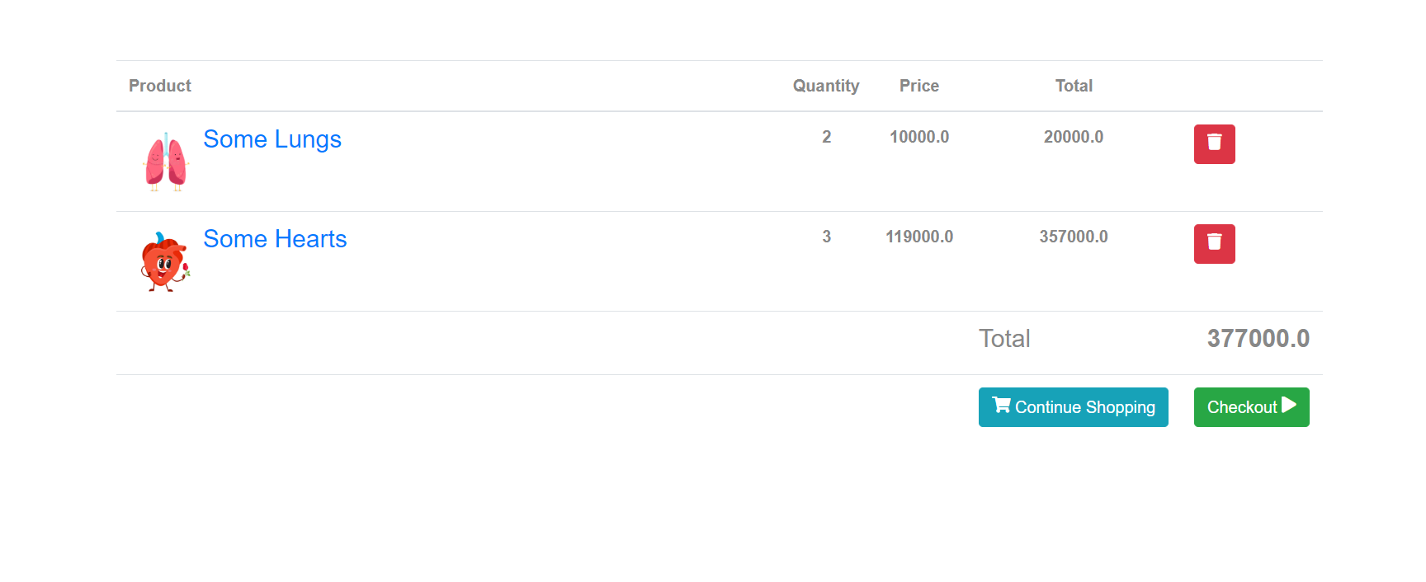

Slide 31
05
Conclusion and Discussion

Slide 32
06 Contribution
Topic | Team Effort | HuyBA – SE140028
Case Study Analysis | 100% | 100%
Database design | 100% | 100%
System design | 100% | 100%
Implementation | 100% | 100%
Documentation | 100% | 100%

Slide 33
THANKS!
Does anyone have any questions?

